Slide 1
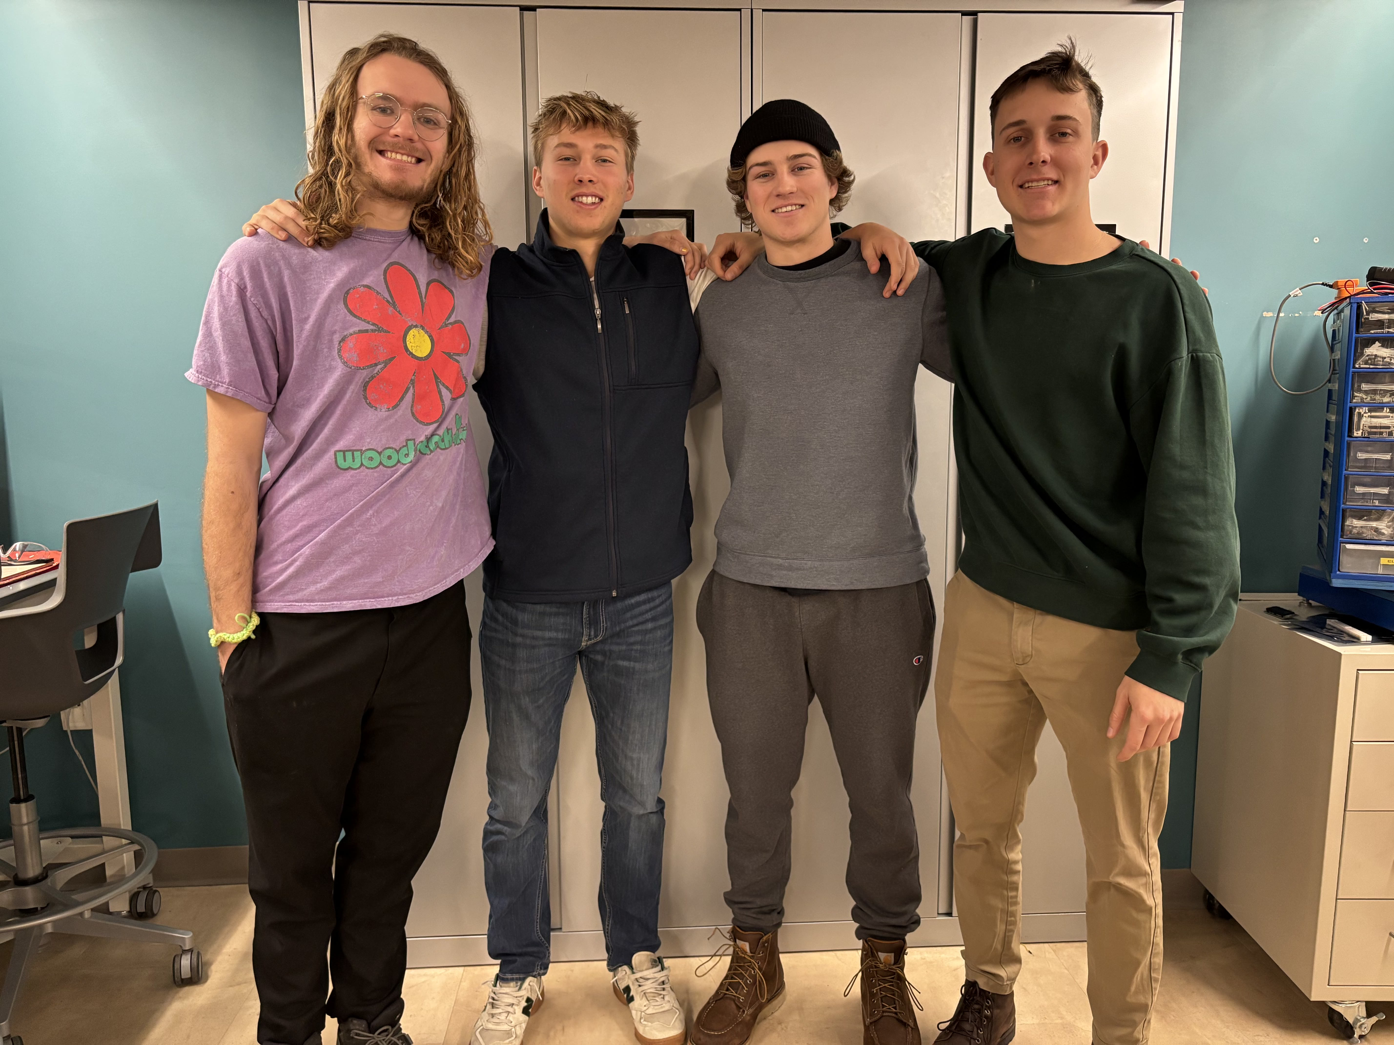
Fairway Finder Midterm Presentation
Team 9

Slide 2




Meet The Team
Marcus Good
Hardware Lead
Liam Kauffman
System Integrations
John Stanwick
Software Lead
Saxon ZumBerge
Team Lead

Slide 3
Agenda
Project Overview
Major Components
Block Diagram
Packaging Design
Electrical Schematic
PCB Layout
Prototyping Progress
Project Timeline

Slide 4
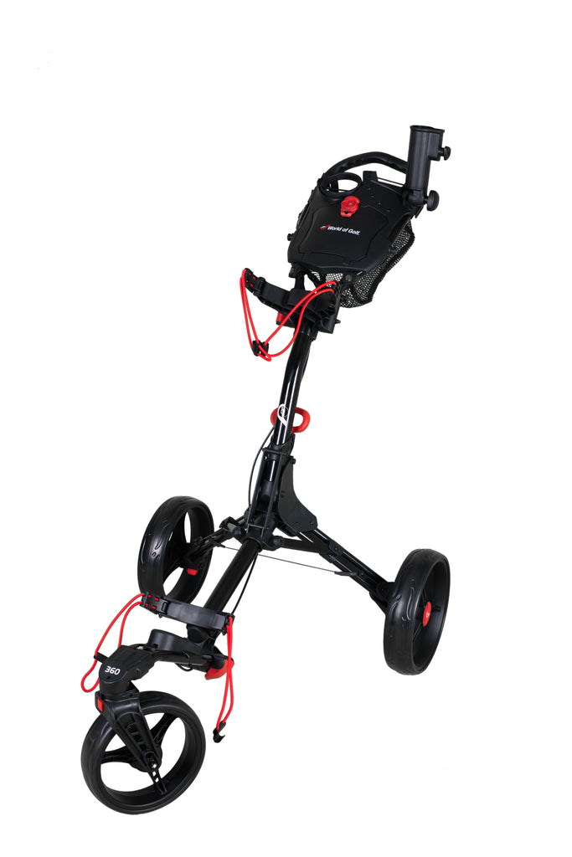
Project Overview
Autonomous, user tracking, golf pushcart
Automatically follows a user around the golf course
User can switch to manual mode and control the caddy via an app

Slide 5
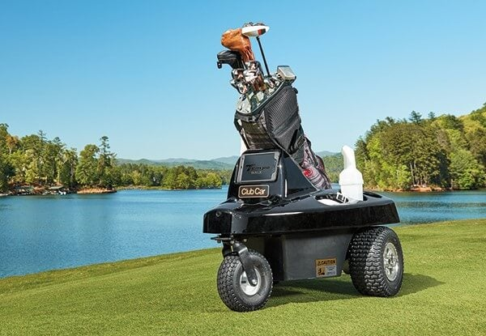
FairwayFinder Vs. Tempo Walk Autonomous Caddie
Similarities:
Autonomous Golf Caddie
Signal Processing and Tracking
Differences:
Size/packaging
Phone App Integration

Slide 6
PSDRs
PSDR #1 (Hardware): An ability to accept 12VDC from a battery and create voltage at 5VDC using a buck converting circuit(s).
PSDR #2 (Hardware): An ability to transmit and receive information from the MCU to a Bluetooth module over the UART communication protocol.
PSDR #3 (Hardware): An ability to control two DC motors using a PWM wave from a microcontroller to two individual H-Bridge motor controllers.
PSDR #4 (Software): An ability to transmit and receive motor control signals via Bluetooth from a phone app.
PSDR #5 (Software): An ability to follow a user using GNSS signals from the user and robot. Transmit GPS coordinates from GNSS module to MCU.
Stretch PSDRs:
Stretch PSDR #1 (Software): Ability to have the IMU's magnetometer transmit positioning data to the MCU over SPI for navigation purposes.

Slide 7
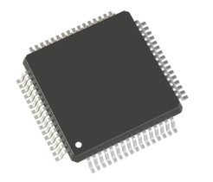
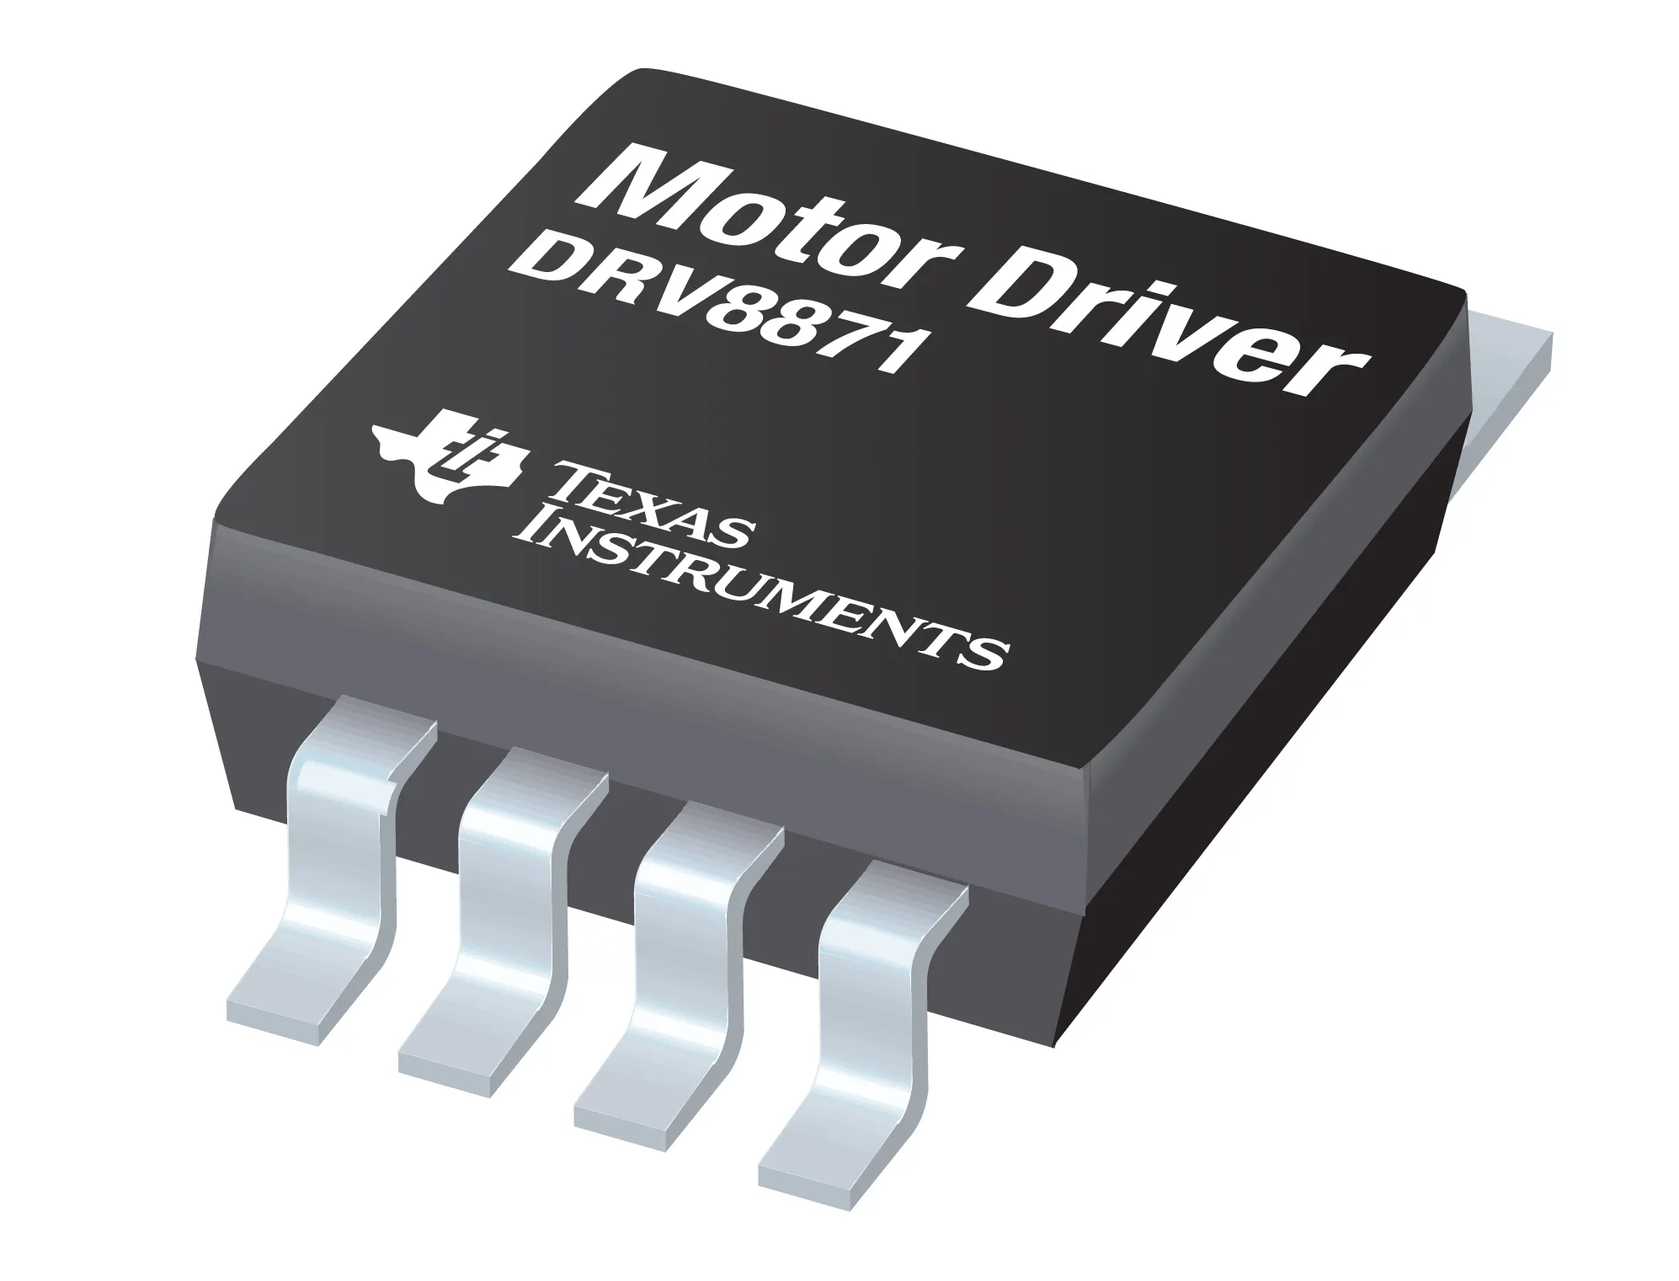
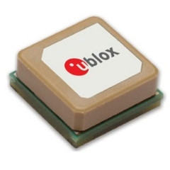

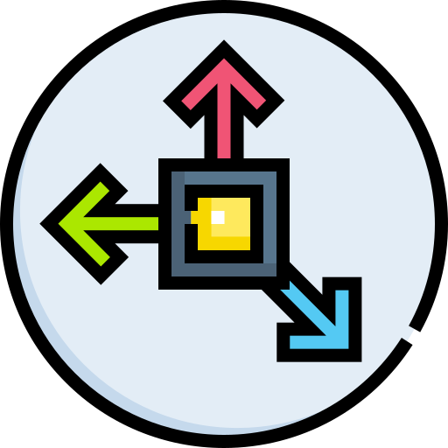
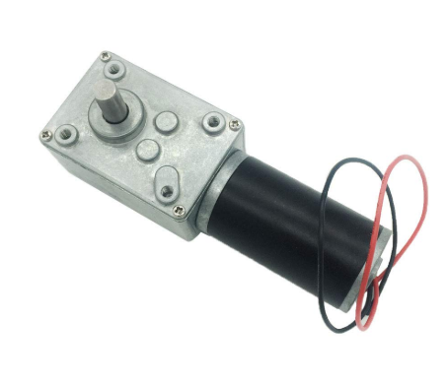
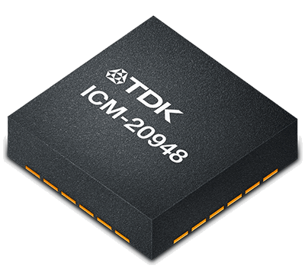
Major Components
1 x STM32F411RET6 Microcontroller
1 x SAM-M8Q GNSS Sensor
1 x HM-10 Bluetooth Sensor
1 x ICM-20948 Magnetometer Sensor
2 x A58SW31ZY 160 RPM Motors
2 x DRV8871 Brushed DC Motor Driver
1 x BP7-12 12 V Rechargeable Lead-Acid Battery

Slide 8
STM32F411RET6 Microcontroller
Main software-driving microcontroller
VCC Input: 3.3v
DMA Channels: 2
UART Interfaces: 3
SPI Interfaces 3

Slide 9
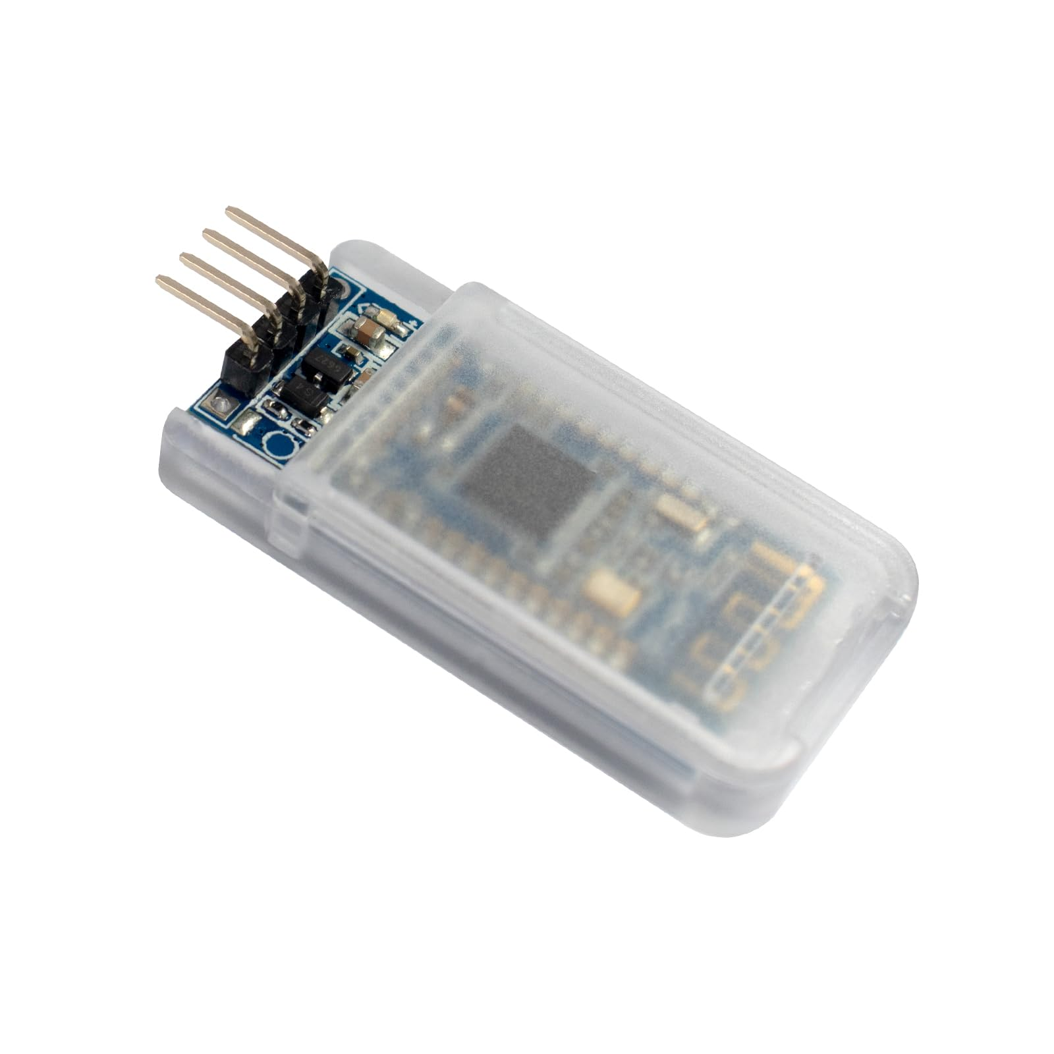
HM-10 Bluetooth Module
Bluetooth and BLE Transceiver
VCC Input: 3.3v
RF Power: -23dbm, -6dbm, 0dbm, 6dbm
Interface: UART

Slide 10
ICM-20948 Magnetometer Module
Magnetometer to allow for directionality measurement
VCC Input: 1.8v
Sensitivity Scale Factor: 0.15 µT/LSB
Interface: SPI

Slide 11
SAM-M8Q GNSS Module
GNSS module for GPS-based robot location tracking
VCC Input: 3.3v
Horizontal Accuracy: ± 2.5m
Cold Time to First Fix: 26s
Hot Time to First Fix: 1s
Interface: UART

Slide 12
DC12V 160RPM Motors
Main wheel-driving motors
VCC Input: 12v
Rated torque: 10kg/cm
No-load speed: 160RPM
Full-Load torque: 1.6A
Stall Torque: 6.5A

Slide 13
DRV8871 Brushed DC Motor Driver
Motor voltage: 12 V
Continuous Current: 2.1A
Peak Current: 3.5A (resistor limit)
Max PWM frequency: 200 kHz
Min Control Voltage: 2V

Slide 14
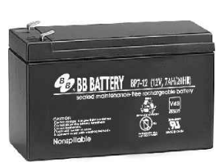
BP7-12 Rechargeable Lead-Acid Battery
12V DC
7 amp hours
Rechargeable

Slide 15
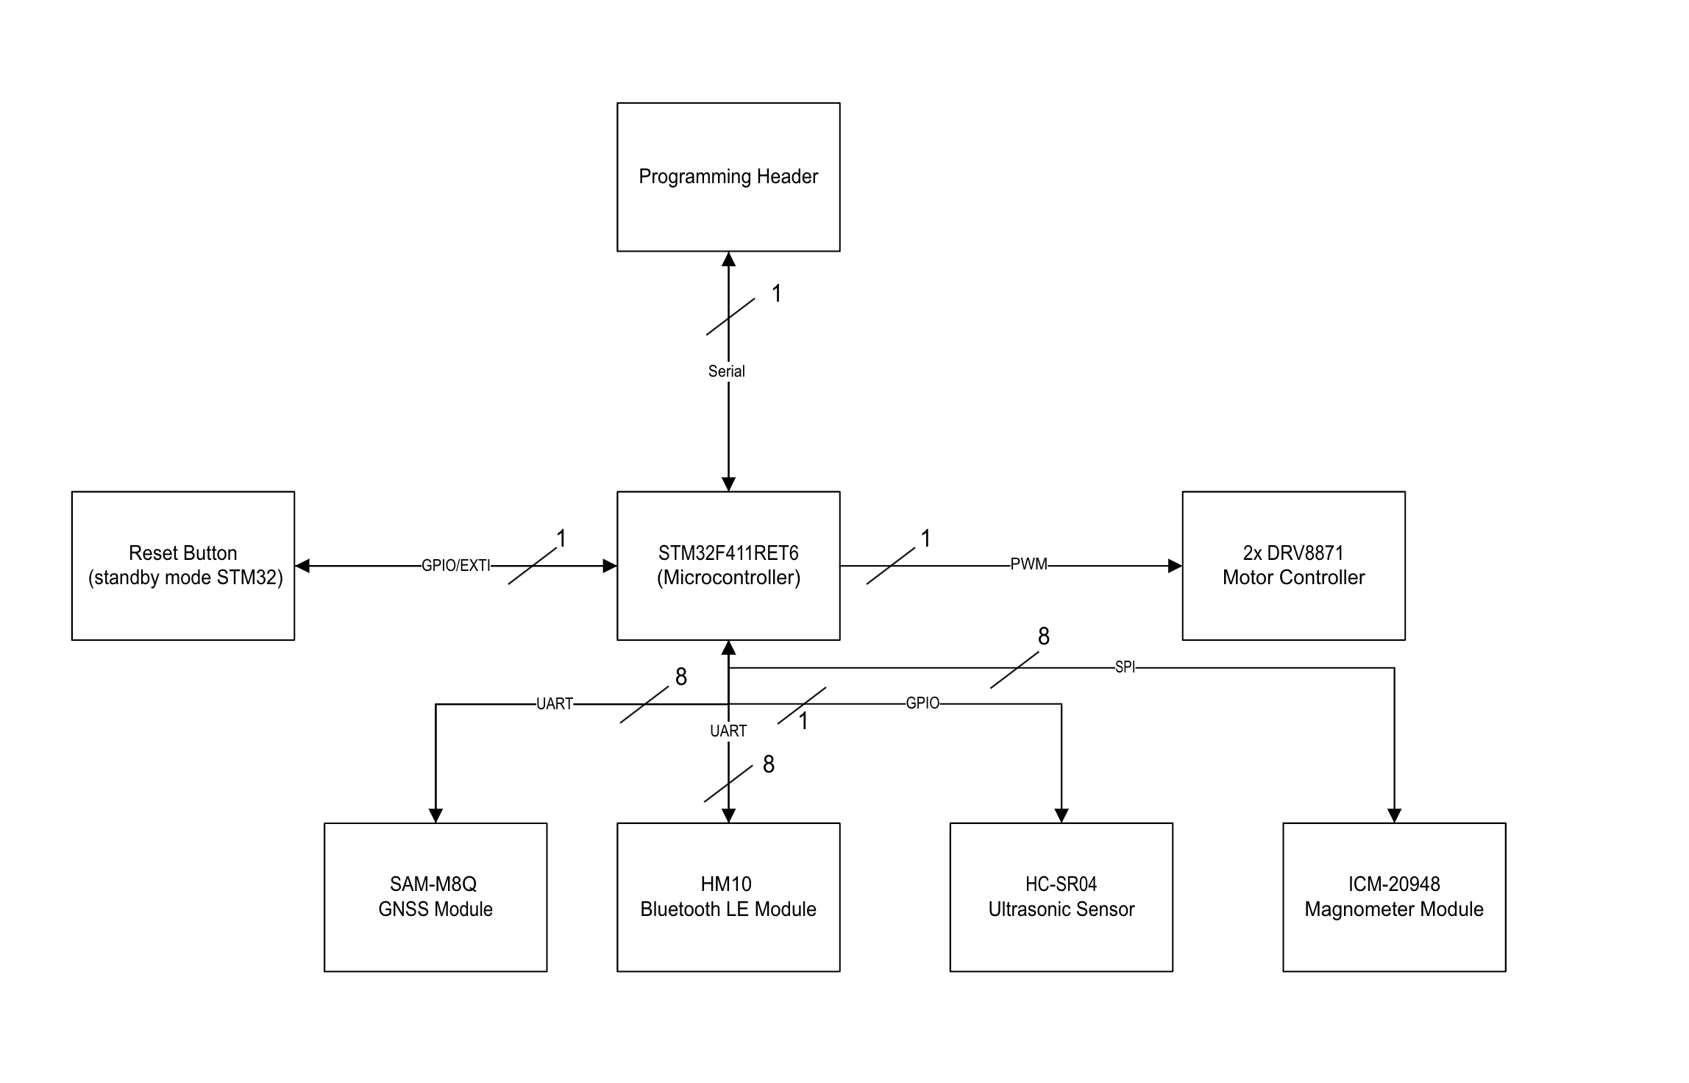
Component Block Diagram

Slide 16
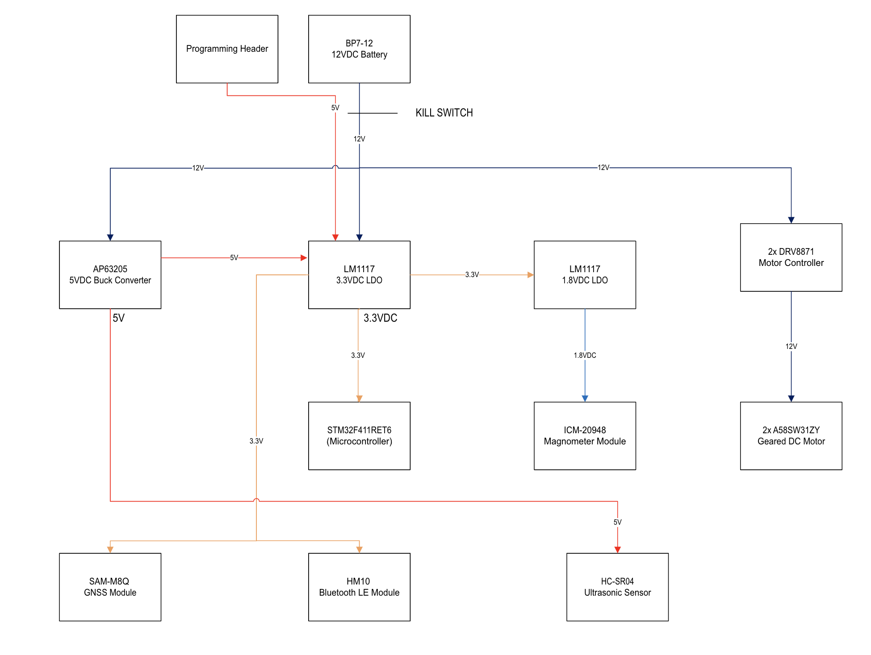
Power Diagram

Slide 17
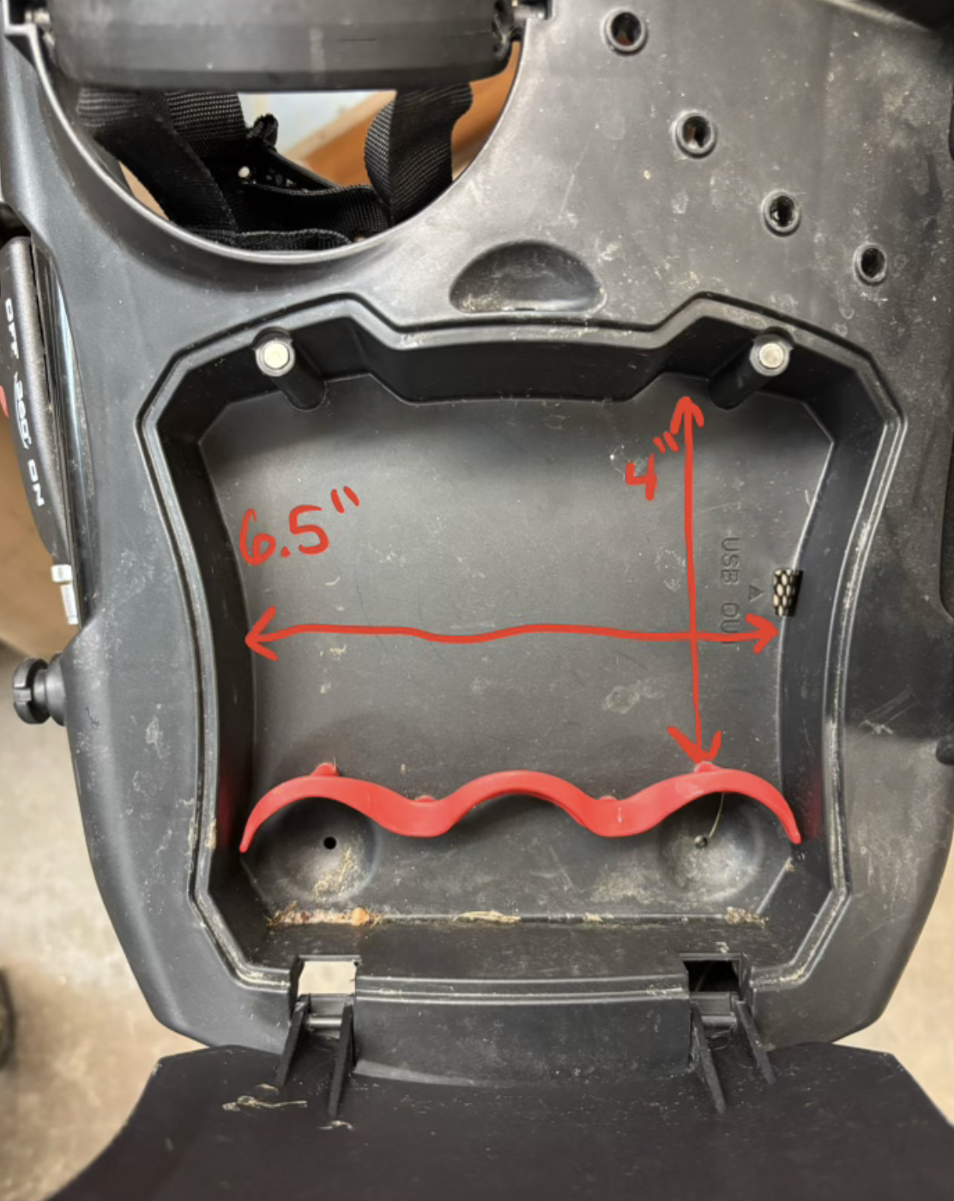
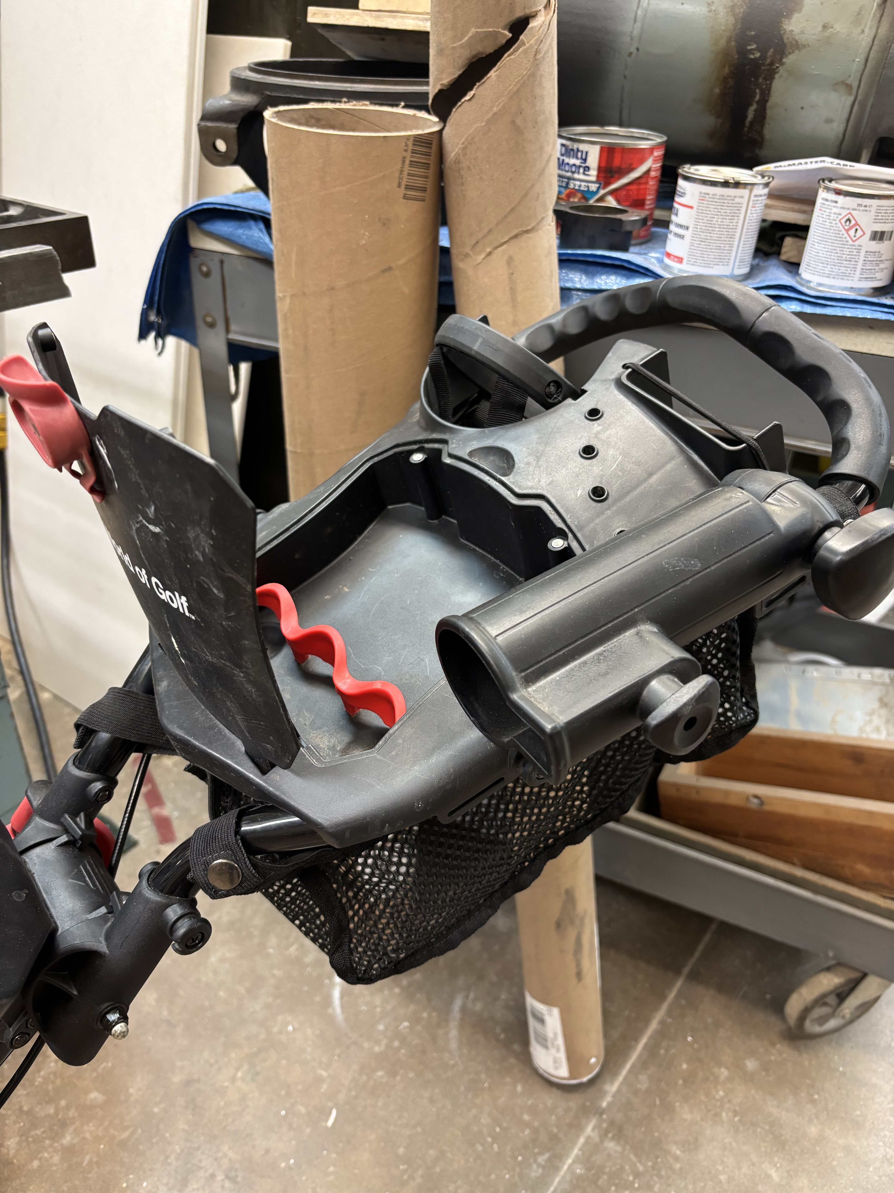
Packaging Design (PCB)

Slide 18
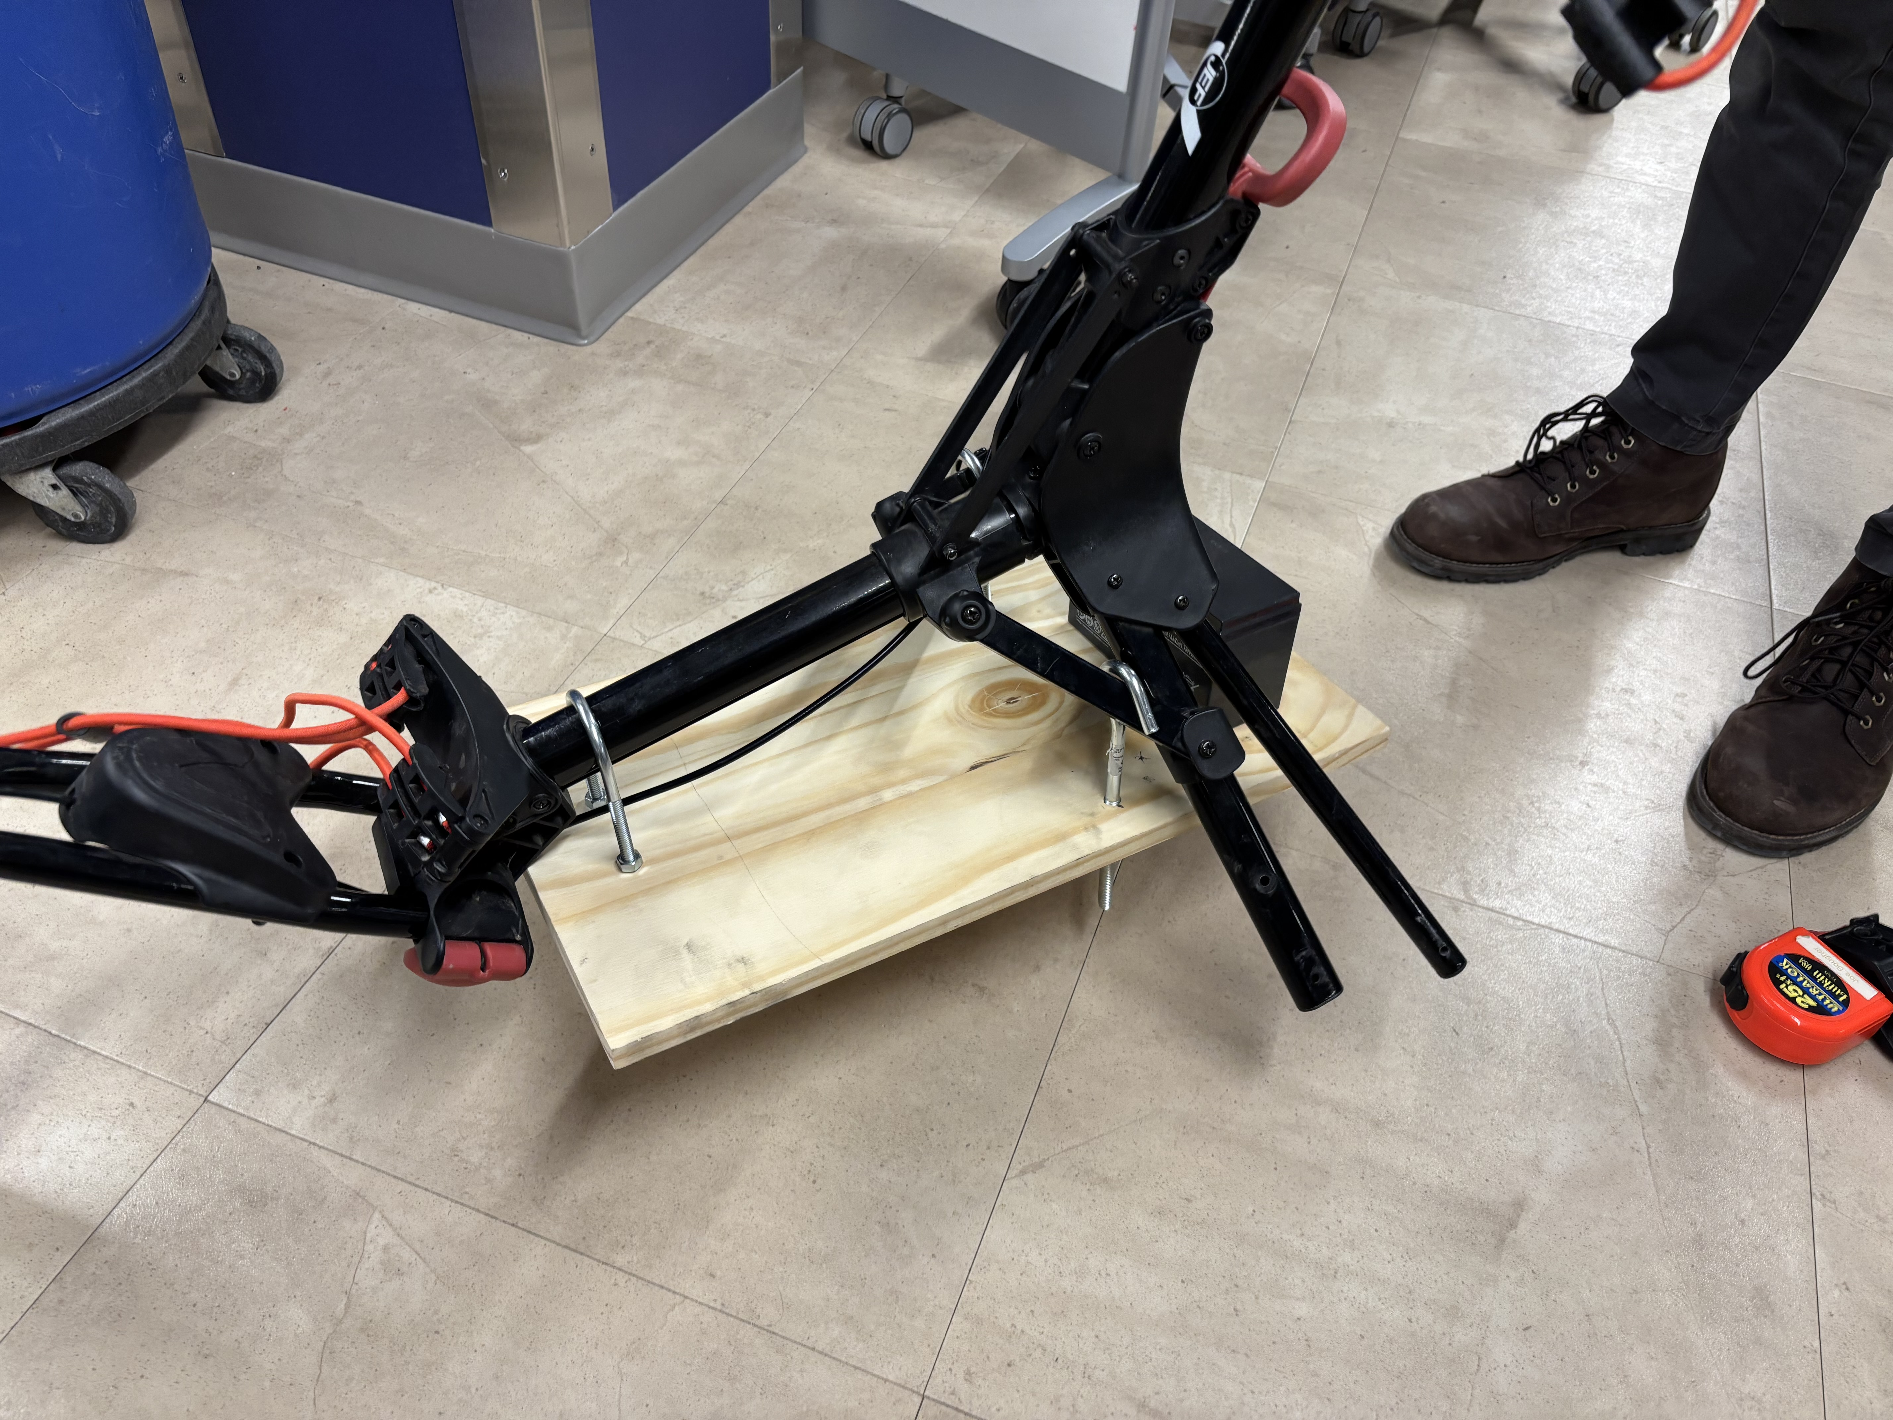
Packaging Design (Battery)

Slide 19
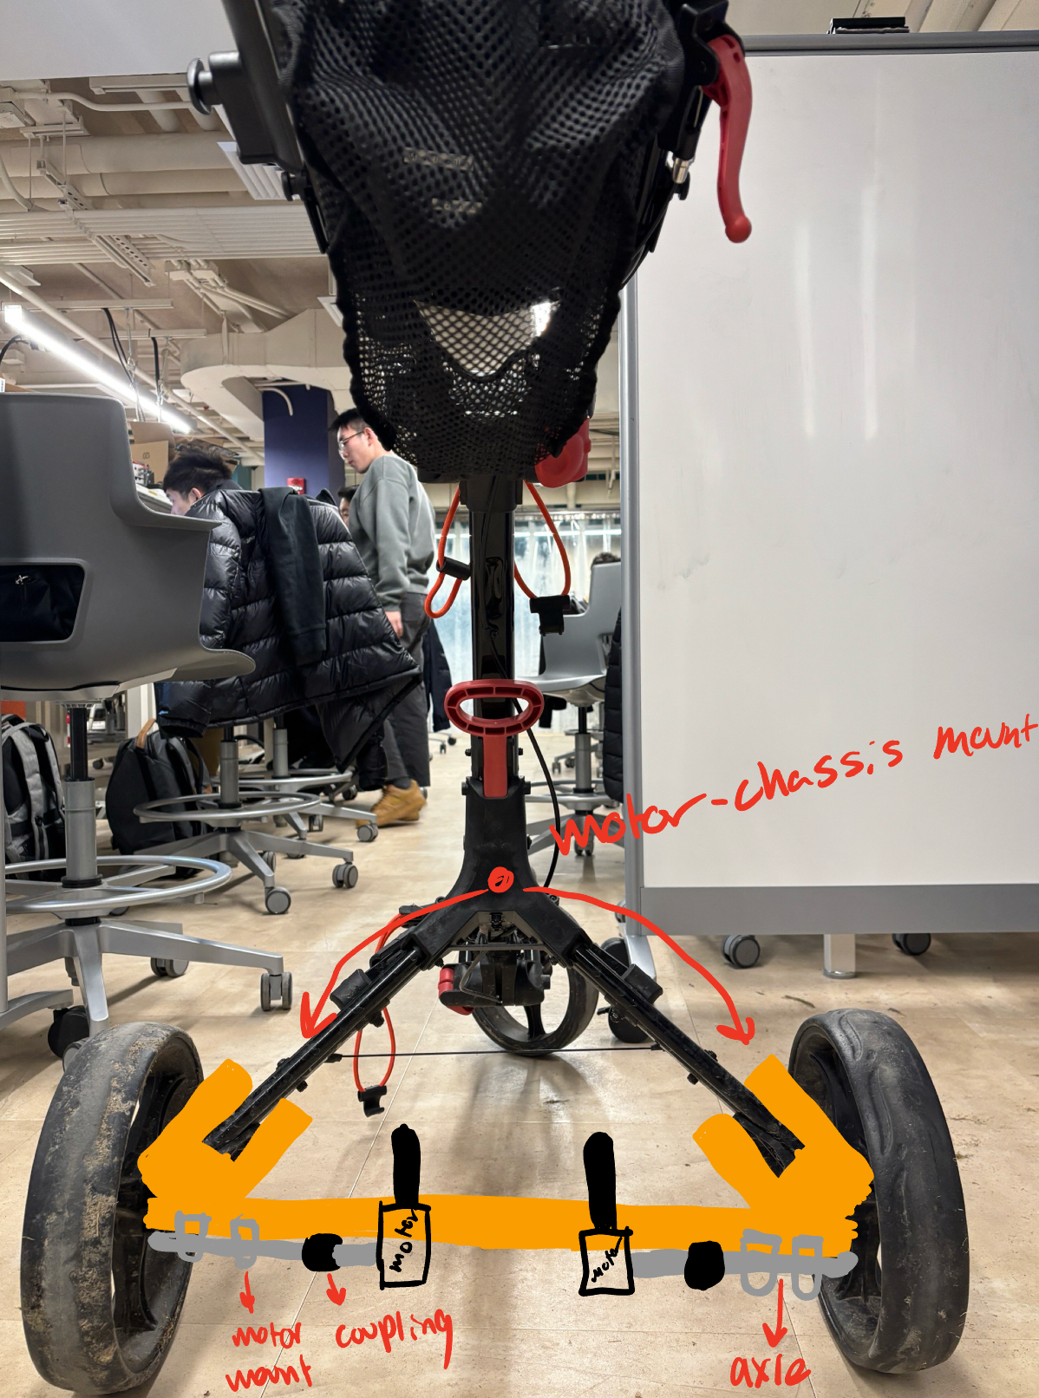
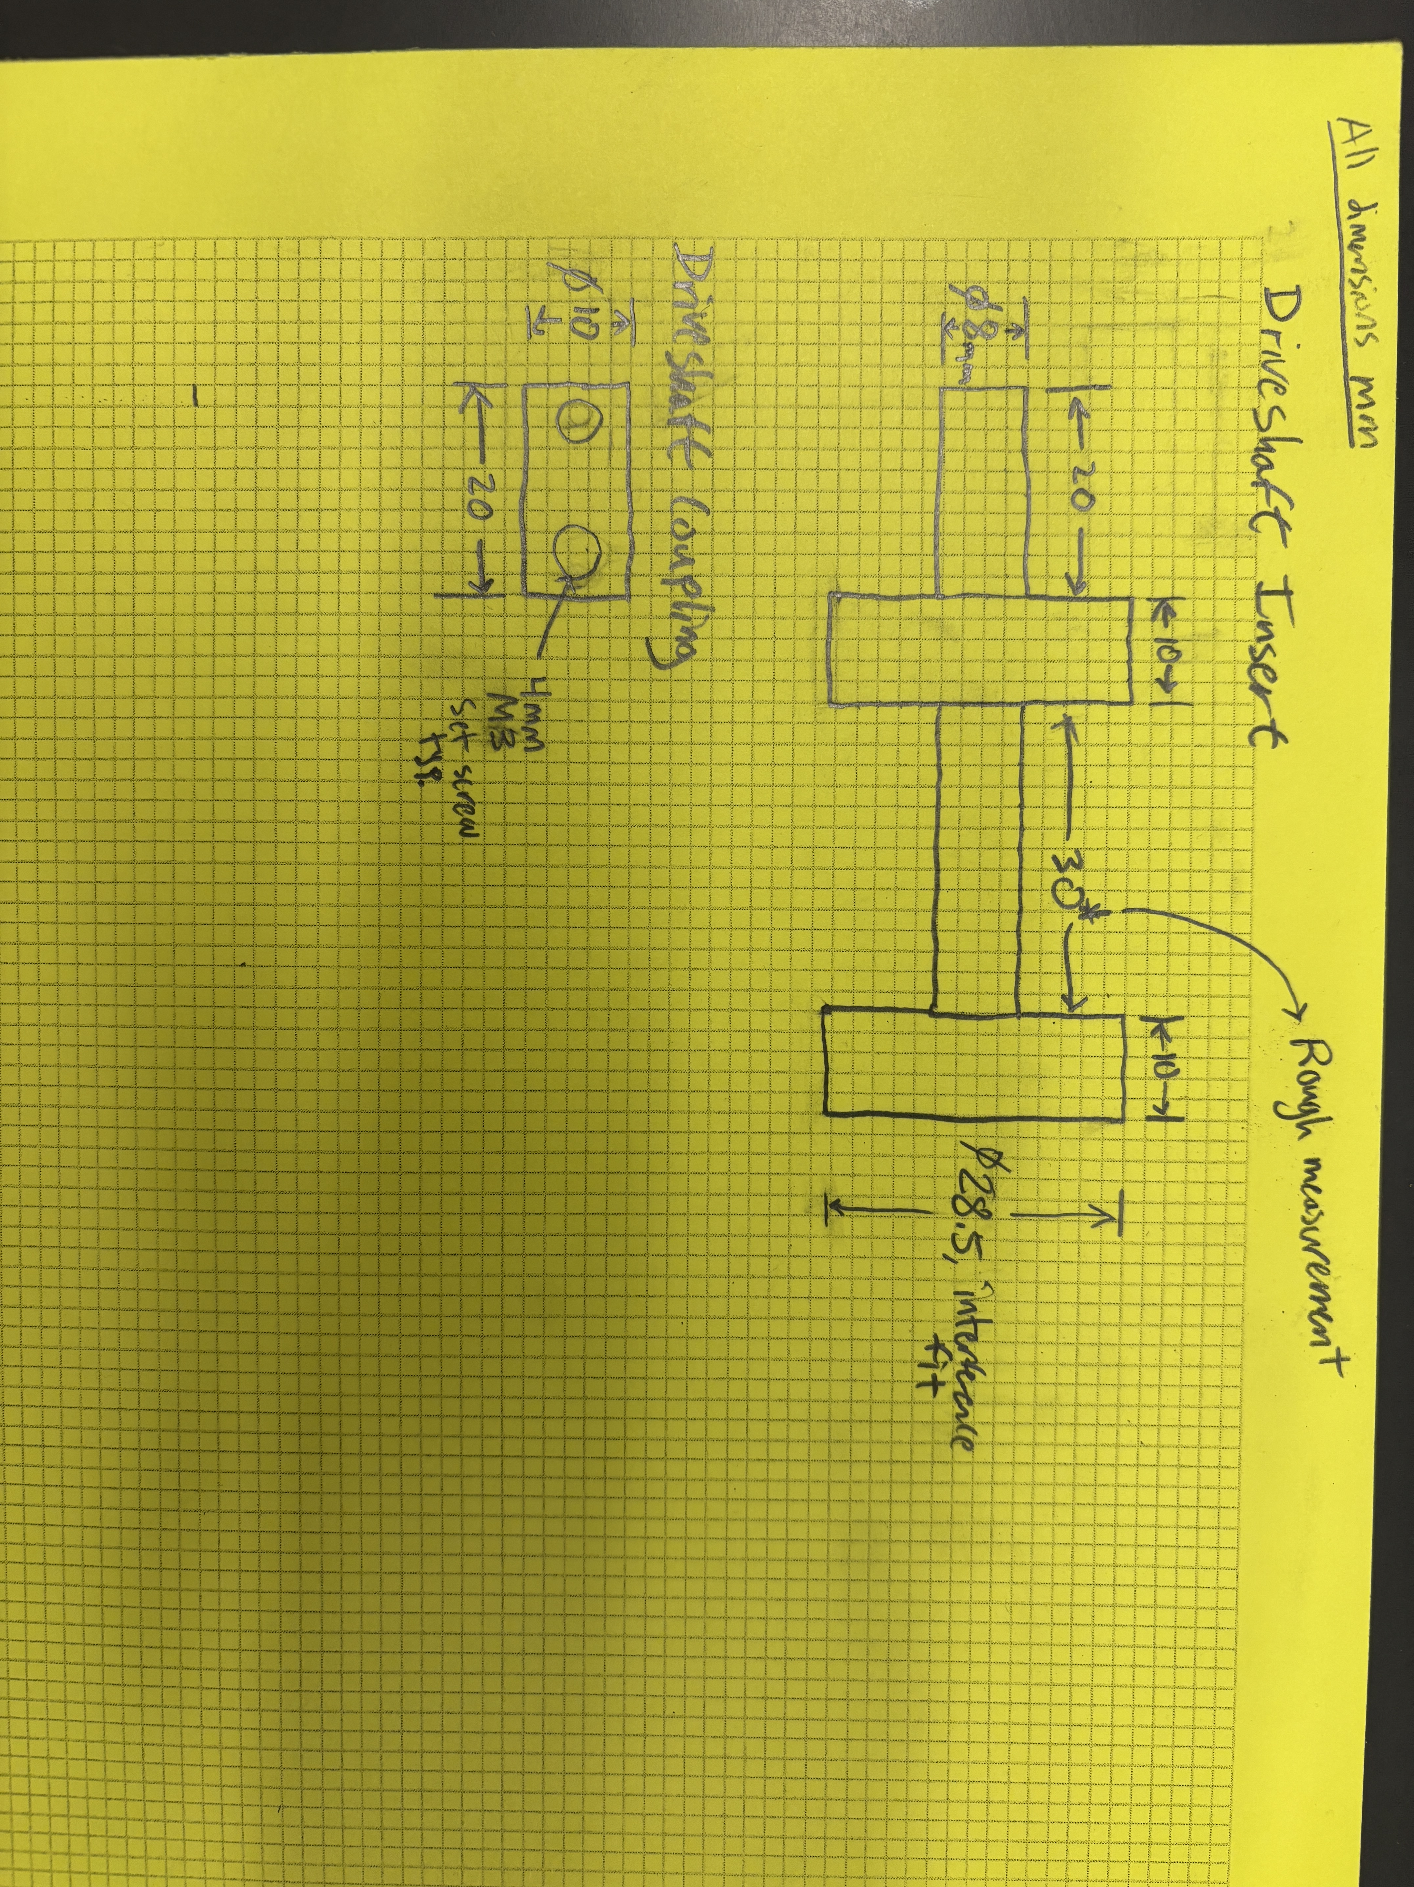
Packaging Design: Drivetrain

Slide 20
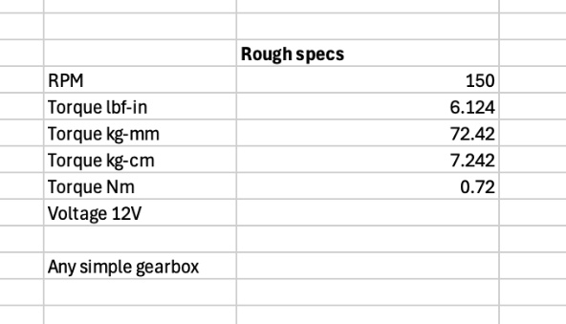
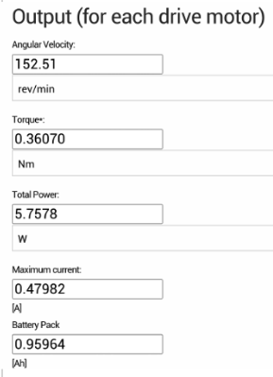
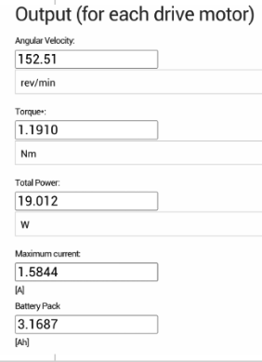
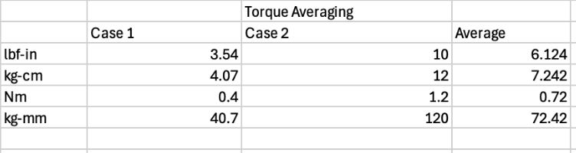
Packaging Design: Drivetrain Power

Slide 21
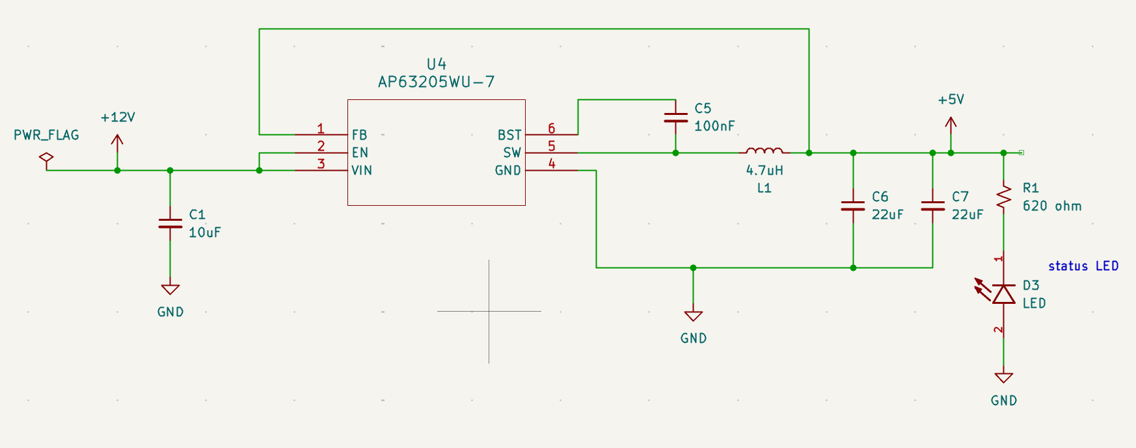
AP63205WU, Voltage Regulator

Slide 22
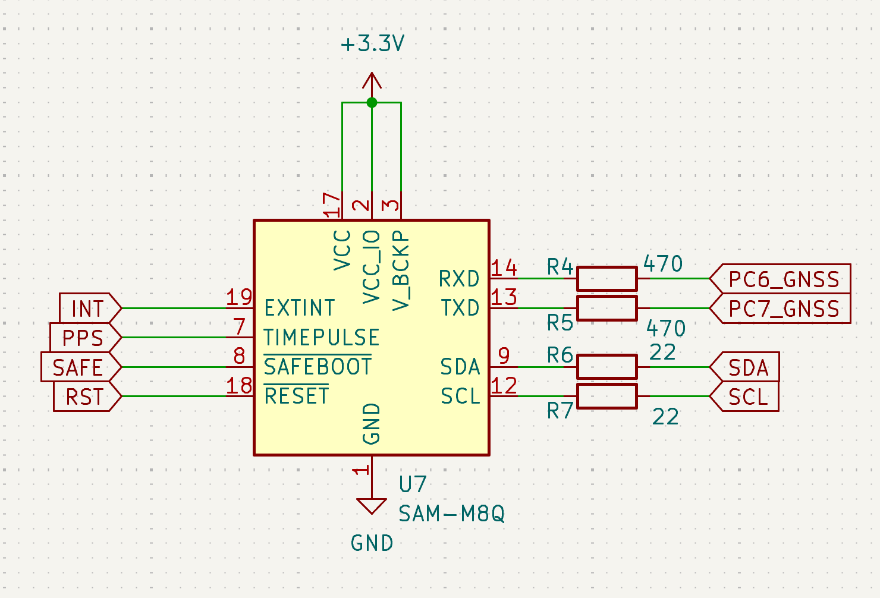
SAM-M8Q, GNSS Module

Slide 23
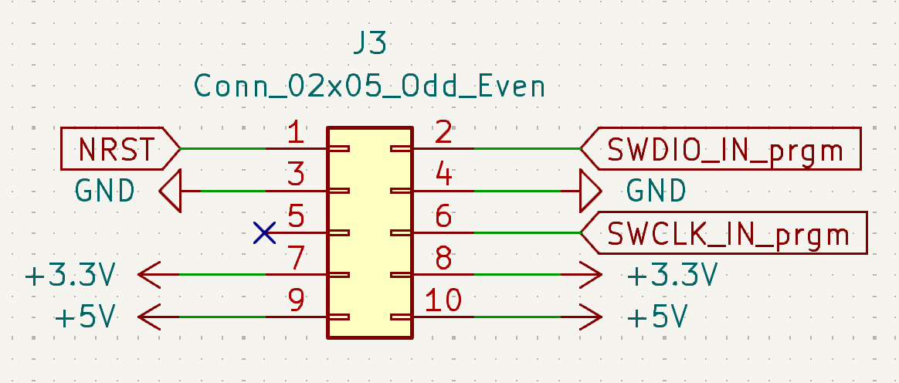
Programming Headers

Slide 24
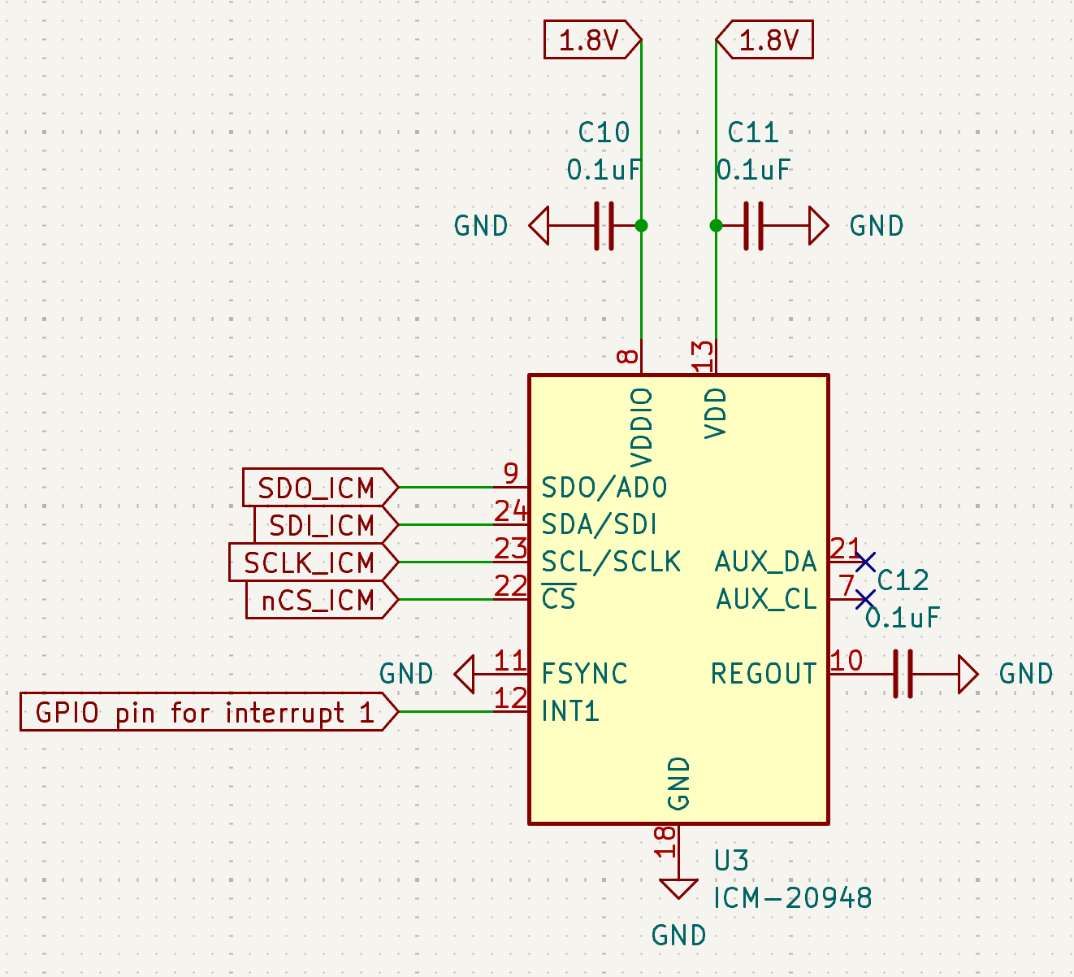
ICM-20948, Magnetometer Module

Slide 25
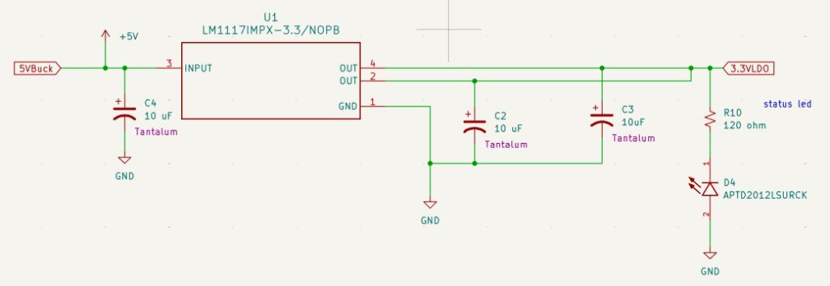
LM1117, Low-Dropout Linear Regulator

Slide 26
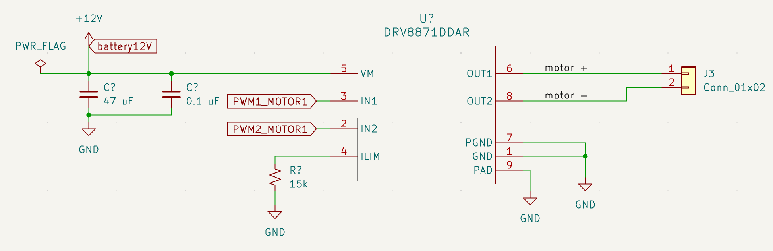
DRV8871, PWM Motor Controller

Slide 27
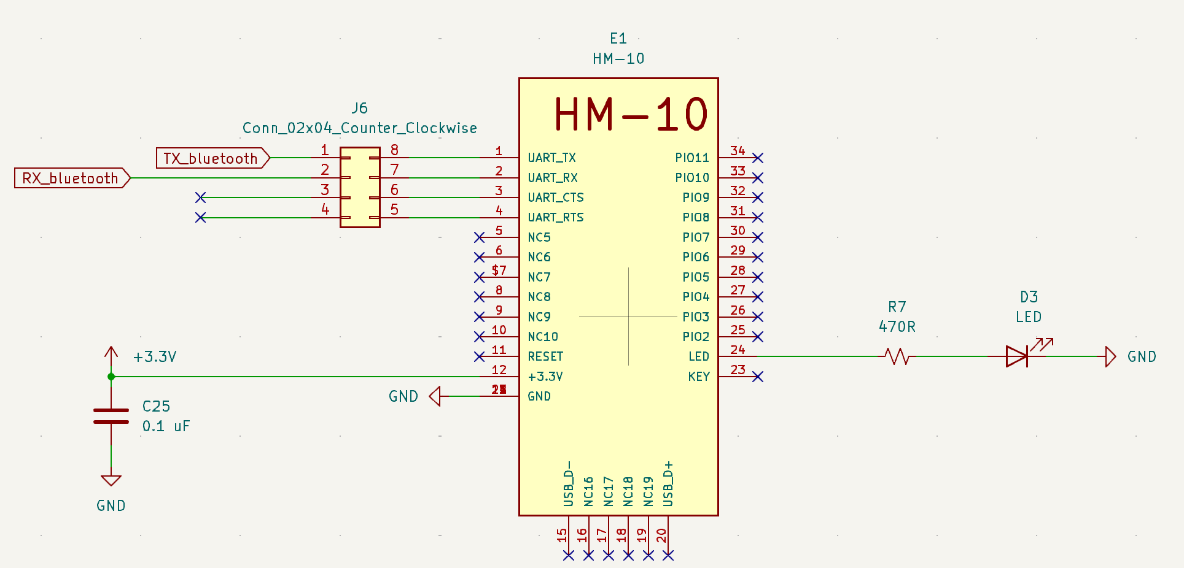
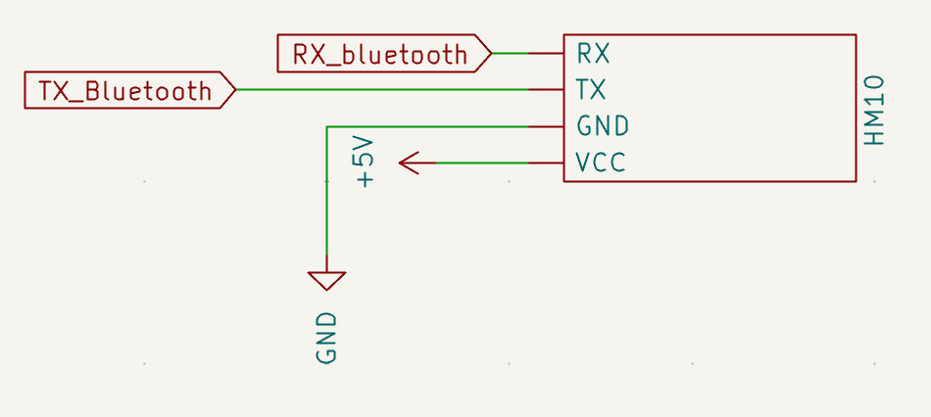
HM-10 Bluetooth Module

Slide 28
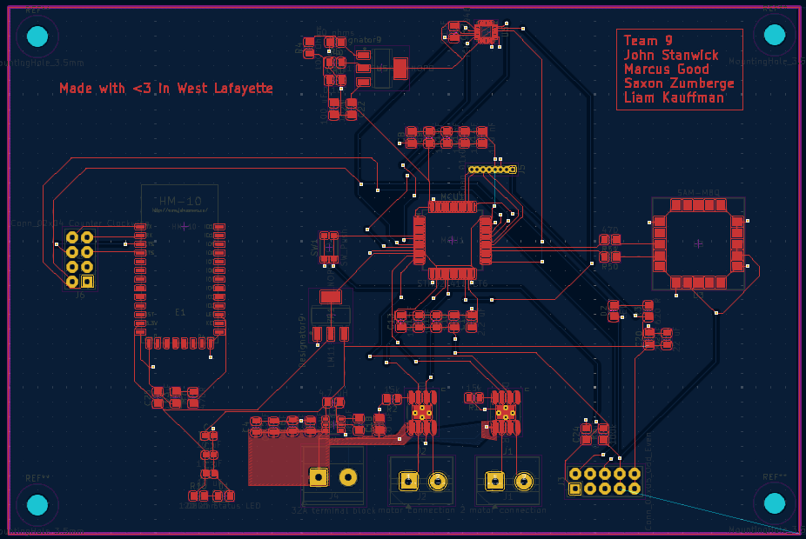
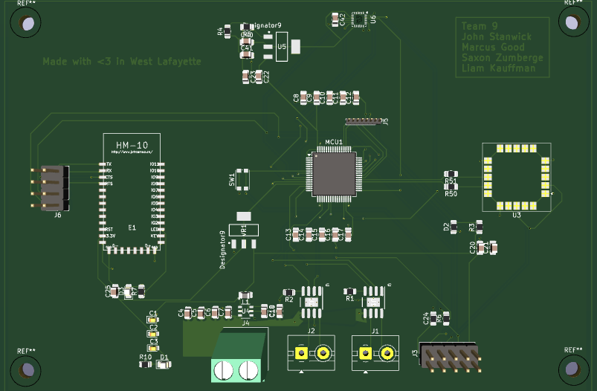
PCB Layout: Overview

Slide 29
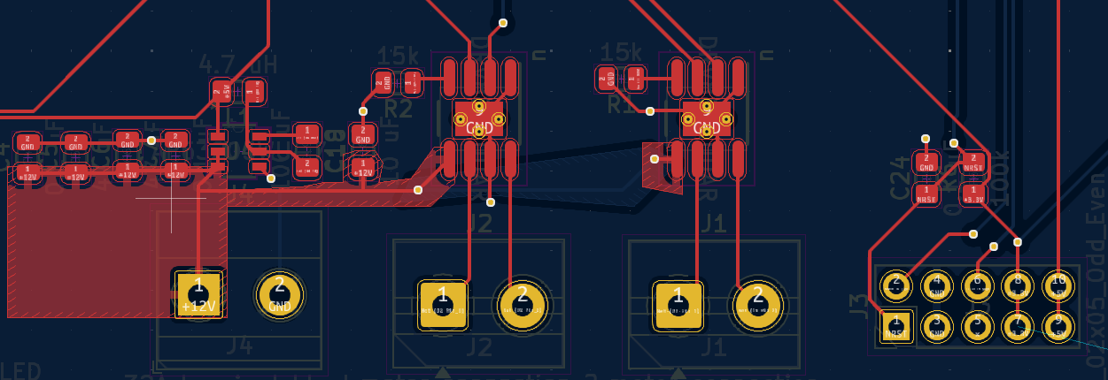
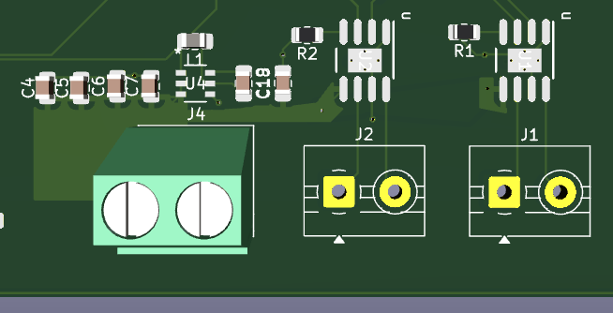
PCB Layout: Buck and Motor Controllers

Slide 30
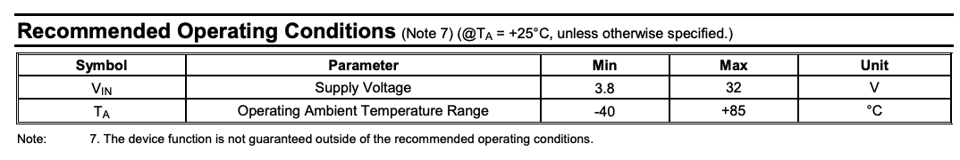
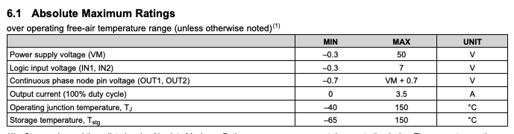
12V Bus Component Operating Temperatures

Slide 31
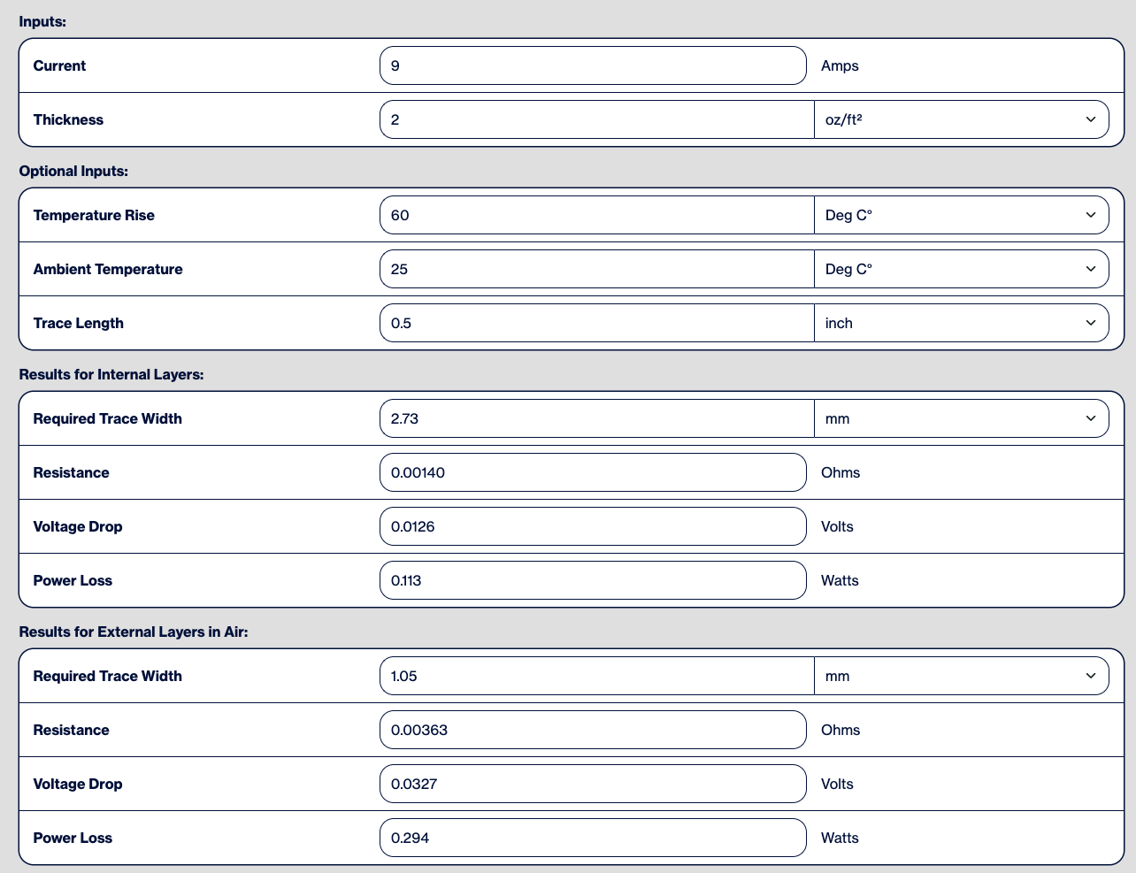
Trace Width Calculations

Slide 32
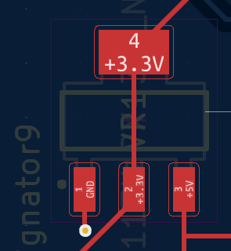
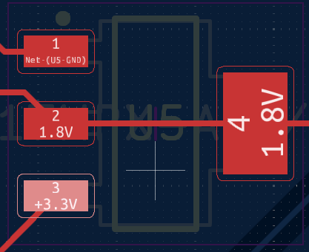
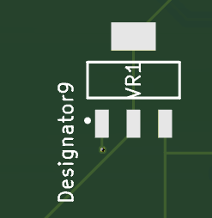
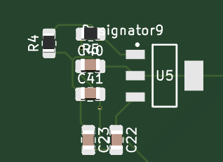
PCB Layout: LDO
5V TO 3.3V
3.3V TO 1.8V

Slide 33
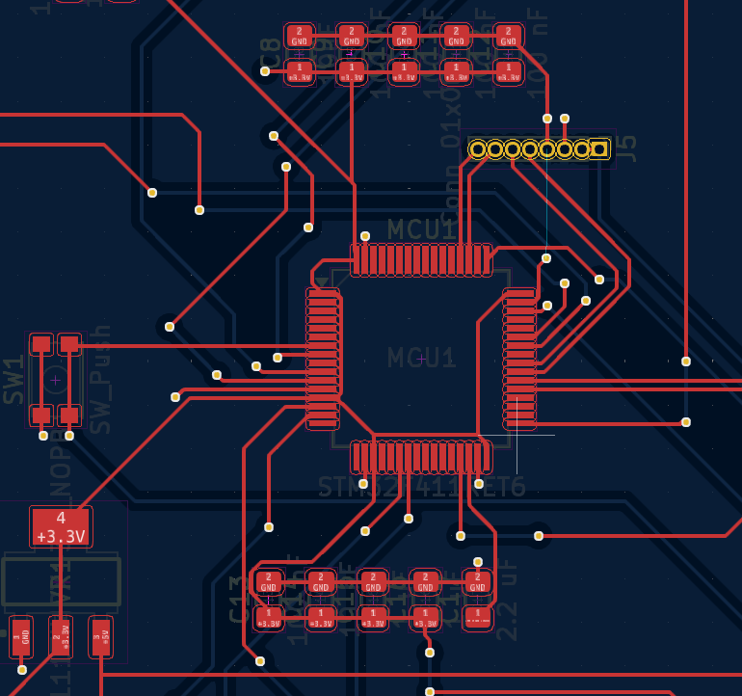
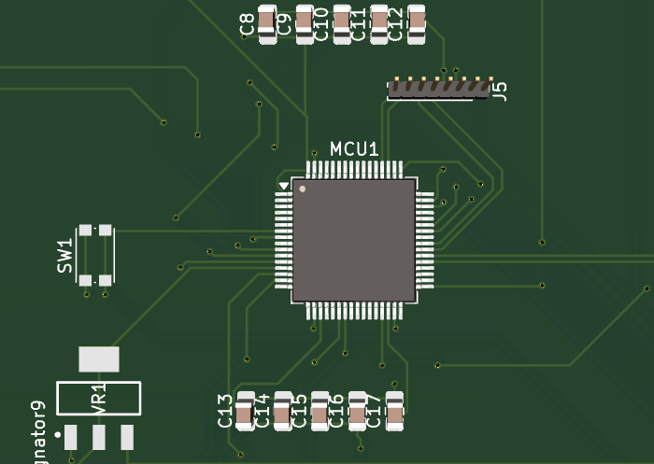
PCB Layout: Microcontroller

Slide 34
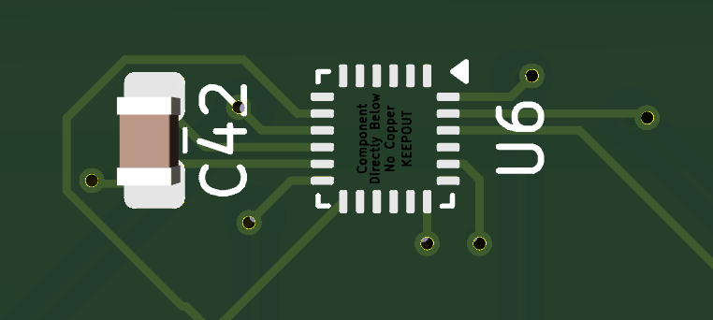
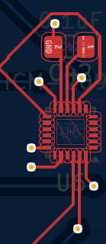
PCB Layout: ICM-20948

Slide 35
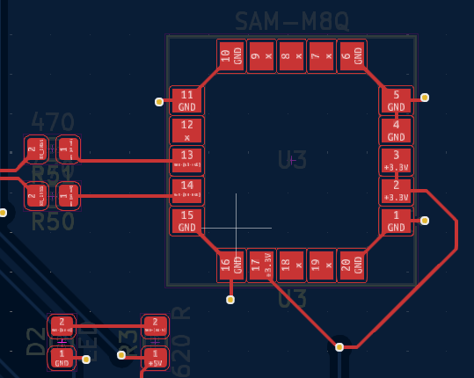
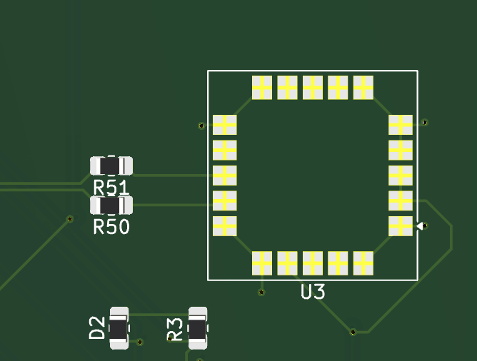
PCB Layout: GNSS

Slide 36
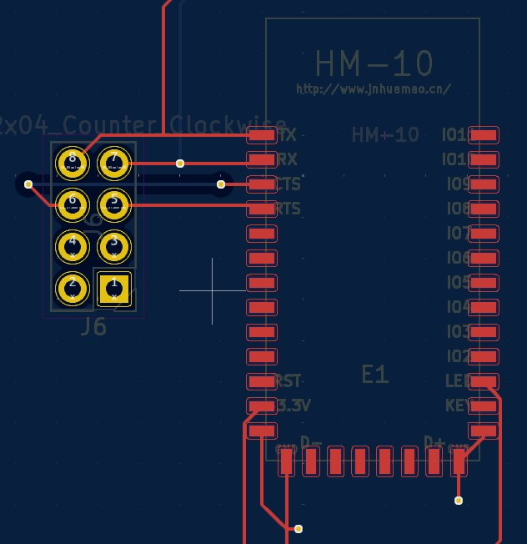
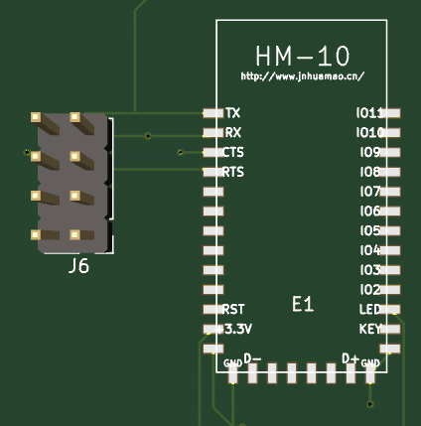
PCB Layout: HM-10

Slide 37
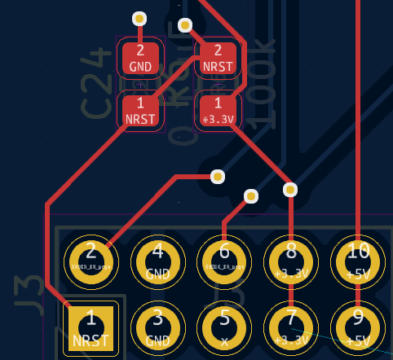

PCB Layout: Programming Header

Slide 38




Prototyping Progress
BLE
GNSS
IMU
Motor Driver
Drivetrain

Slide 39
Motor Driver Module Integration
Successfully designed and tested the motor mount and axle for the robot chassis
Integrated motor controller with STM32

Slide 40
Bluetooth (BLE) Module Integration
Established basic communication between bluetooth module and stm
Working to integrate the mobile app with the bluetooth module

Slide 41

IMU Module Integration
Connected IMU with the stm to send coordinates
Working on translating the directional signals to proper movements of the robot

Slide 42


GNSS Module Integration
Integrated SAM-M8Q GNSS module, successfully retrieving NMEA sentences
Implemented a parse for NMEA codes to extract latitude and longitude data
Refining buffer management to handle incoming data without overflow

Slide 43
Centralized On One Board
Merged individual modules all to same stm board
Finalizing code to properly handle all the modules integrated together

Slide 44

Software
Development
Status
Legend:
Yet to Start
In progress
Complete

Slide 45

Software Development Status

Slide 46


Software
Development
Status
Created React Native App
Basic Right, Left, Straight, Backward Command UI
Basic signals UI and functionality
Next steps: connect with HM10, transmit GPS coordinates, UX/UI Improvements

Slide 47

Project Timeline

Slide 48
Questions?

Slide 49
Rubric links for pres
How we will be reviewed by students: https://purdue.brightspace.com/d2l/le/dropbox/1216648/1195571/DownloadAttachment?fid=44274002
Actual survey: https://purdue.brightspace.com/d2l/le/dropbox/1216648/1195571/DownloadAttachment?fid=44274004

